Slide 1
Medical Clearance and Return to Work Training
for
Food Services Managers
Provided by the LAUSD Food Services Division
11.20.2015
Notes:
Must use the FSD approved Power point template-will be provided to each trainer
Title Page: Calibri Black, 40 to 44 size font, centered
Provided by the LAUSD Food Services Division: Calibri, 24 font, centered
Date: Calibri, 12 size font
All power points should have an overview, purpose and benefits, objectives, course content, resources and questions pages.

Slide 2
Overview
This training will provide managers an overview of the medical clearance and return to work procedure. This training will address the following areas:
Medical clearance
Required documentation
Role of the Food Services Manager
Responsibilities
Notes:
READ SLIDE

Slide 3
Purpose and Benefits
To ensure health and safety of staff and students
The Food Services Division provides great tasting and healthy meals, free from transmissible diseases
Cafeteria staff returning from an injury may return to work with or without work restrictions
Allows the cafeteria to operate in an efficient and effective manner
Notes:
READ SLIDE

Slide 4
Objective
The objective is to confirm proper medical clearance and documentation is received from staff who are absent from work.
Depending on absence, certain medical clearance is needed to return to work
Depending on absence, certain documentation is needed to return to work
Notes:
READ SLIDE

Slide 5
Illness - Less than five days
When an employee absence is less than five consecutive work days, certification is needed.
The employee should report the absence two hours before start time, but no later than one hour after start time
The Manager should document absences on the Absence/Tardy/FMLA Log
Employee completes the Certification/Request of Absence for Illness, Family Illness, New Child
Managers should provide FMLA to staff who are admitted overnight in hospital, require two treatments per year or periodic flare-ups preventing normal activities
Notes:
Illness – Review slide
Employees should call in to report their illness to their immediate supervisor two hours prior to start time. However, café manger may not be available, employee should call in no later than one hour after start time.
An employee must call in everyday, unless the employee has provided documentation from a health care provider for an extended absence or leave.

Slide 6
Certification of Illness Form
Notes:
Certification of Illness Form – Review slide
Employee must fill-in their personal and job related information.
The employee must fill-in the Reason for Absence section 1 - 4, date, duration of absence, and type 4-A1.

Slide 7
Certification of Illness Form - cont
Notes:
Certification of Illness Form – Review slide
Is the absence FMLA related? Employee should check off the appropriate boxes in 5A through 6.
Physician Statement is required for an absence more than 5 consecutive days. A Health Appraisal Form is required as well and will be covered in a later slide.
The employee must sign and date to certify their absence. The Cafeteria Manager signs and dates for the Supervisor’s Acknowledgement section, forward to SAA/Timekeeper for processing.

Slide 8
Illness – more than five days
When an employee is absent more than five consecutive work days for illness, injury or surgery, certification and medical clearance is needed.
The employee should report the absence as soon as possible, but no later than one hour after start time
Employee is required to submit to supervisor written documentation by the 3rd day to explain absence
The Absence/Tardy/FMLA and Certification of Illness must be completed
Notes:
Review slide
Employees should call in to report their illness to their immediate supervisor two hours prior to start time. However, café manger may not be available, employee should call in no later than one hour after start time.
An employee must call in everyday, unless the employee has provided documentation from a health care provider for an extended absence or leave.
If proper documentation is not received timely from the employee, employee should be unpaid (UP).
NOTE: Unless written documentation is submitted, failure to return to work after the fifth consecutive working day, the absence may be considered AWOA. Progressive discipline should be followed.

Slide 9
Absence/Tardy/FMLA Log
Notes:
Absence/Tardy/FMLA Log
The Cafeteria Manager should have an Absence/Tardy/FMLA Log for each employee.
The Manager should check off appropriate box/boxes, Incident Log, Counseling record, AWOL, or FMLA.
When employee calls in, he/she should be indicating to Manager the reason for being absent. Personal illness, workers comp injury, FMLA, Personal Necessity or Kin Care.
The Manager should be recording absences indicating relevant dates, minutes, days, reason, and if employee called in.

Slide 10
Absence/Tardy/FMLA Log - cont
Notes:
Absence/Tardy/FMLA Log – cont
The Cafeteria Manager should review the Absence/Tardy/FMLA Log with staff periodically. This procedure will ensure staff are mindful of how absences may impact their performance evaluation.
Employee and Cafeteria Manager must sign and date at the bottom of the form.
Retain a copy in the cafeteria employee file, give a copy to employee, and send original to the Food Services Division – Human Resources.

Slide 11
Medical Clearance
Medical clearance is needed when an employee is returning to work from an absence.
A FSD Health Appraisal Form is required when an employee is absent more than five (5) days
Intent to Return to Work is required for returning from a Leave of Absence, illness or injury
Fitness for Duty- clearance is required from Dr. Mercado in Employee Health Services
WC related injury- clearance is required from the treating workers comp doctor/clinic
Notes:
Medical Clearance
The Health Appraisal Form is required so FSD staff are cleared to work around food. The clearance can be conducted by a school nurse or a District doctor.
The treating doctor must complete the Intent to Return to Work for an employee on a approved leave of more than twenty (20) consecutive days. The Intent to Return to Work must be submitted to the Personnel Commission, currently Cindy Garcia or Emily Fernandez.
Fitness for Duty: The employee would be pulled from the work site for health and/or safety reasons.
When an employee is returning from a work comp absence, review any work restrictions and is they can be temporary accommodated.

Slide 12
Health Appraisal Form
Notes:
Medical Clearance
The Health Appraisal Form is required so FSD staff are cleared to work around food. The clearance can be conducted by a school nurse or a District doctor.
The treating doctor must complete the Intent to Return to Work for an employee on a approved leave of more than twenty (20) consecutive days. The Intent to Return to Work must be submitted to the Personnel Commission, currently Cindy Garcia or Emily Fernandez.
Fitness for Duty: The employee would have been pulled from the work site for health and/or safety reasons.

Slide 13
Returning to Work
Cafeteria Managers should ensure of the following:
Employee calls the day before returning to work at least one (1) hour before the end of the work day
Work restrictions must be written, detailed and not vague
Managers should complete a Transitional Assignment Plan
If work restrictions are too limited, the employee should not be temporarily accommodated
Notes:
Returning to Work
If employee does not call the day before, one (1) hour before the end of the work day, a sub that has been scheduled has the right to work the assignment. Your permanent worker can be sent home unpaid for not following the FSD policy/procedure.
A worker returning with restrictions must be cleared by the immediate supervisor. Example of vague restriction is, “do not left heavy objects.” Example of clear restriction is, “do not left/push/pull objects weighting more than 20 lbs with left hand/arm.
Some examples of restrictions that are too limited: no standing, no lifting/pushing/pulling more than 5 lbs, and no bending/twisting. The employee can be placed in a site that may be able to utilize such an employee; however, the safety and health of the employee should be considered.

Slide 14
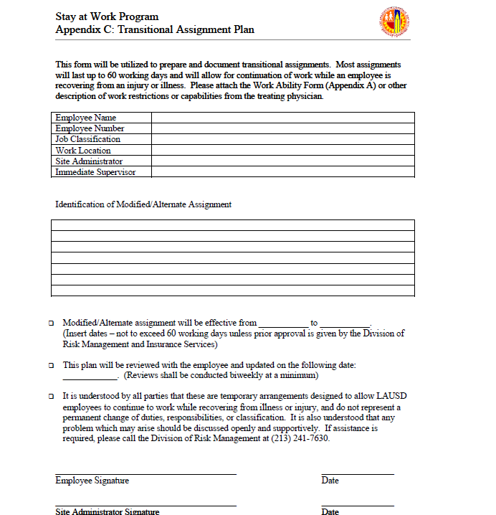
Notes:
Transitional Assignment Plan
Complete the relevant employee and cafeteria site information.
Fill-in the temporary restrictions as noted in doctors/clinic note in the Modified /Alternate assignment area.
Fill-in the date range and the date the plan will be reviewed.
Employee and Cafeteria Manager must sign and date at the bottom of the form.

Slide 15
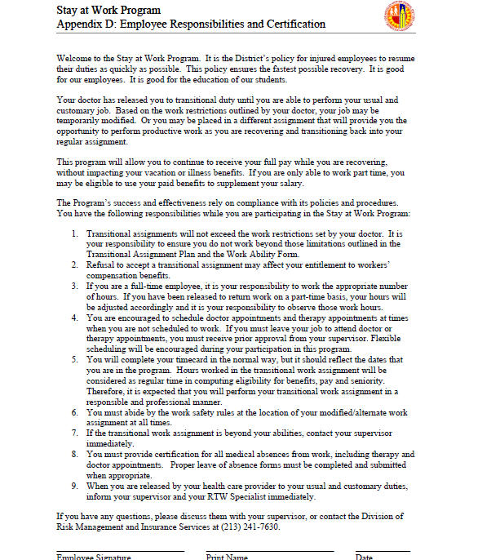
Notes:
Employee Responsibilities and Certification
The document lists the employee’s responsibility of this plan.
The employee should be following the work restrictions and keep scheduled appointments.
The employee must provide certification for all medical absences from work, including therapy and doctor appointments.
If the employee is working within the restrictions, but complains of pain, should be sent back to the treating doctor and not home.

Slide 16
Questions?
Thank you!
LAUSD Food Services Division
Nourishing Children to Achieve Excellence

